Slide 1
A Predictive Model for Foraging
Isabel Garcia
Gordus Lab
Department of Biology
Johns Hopkins University

Slide 2
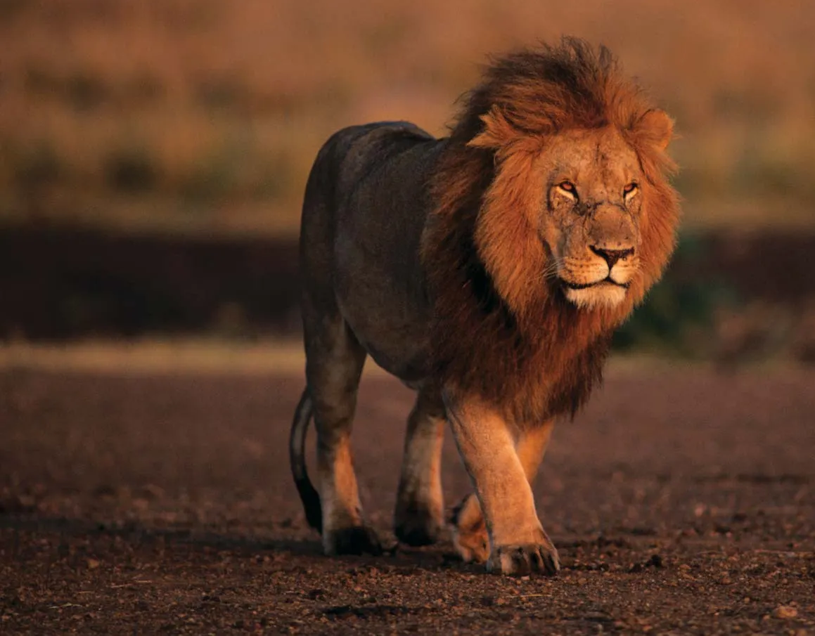
Why is foraging important?
Food is patchy!
High
Low
High
Low
Notes:
food in the wild is patchy!
Ex. lion may find a huge herd of zebras one day but this lion does not know where the next patch is
must go on a random search for the next patch and this is true for all animals
Trying to track a large animal is difficult over lots of time

Slide 3
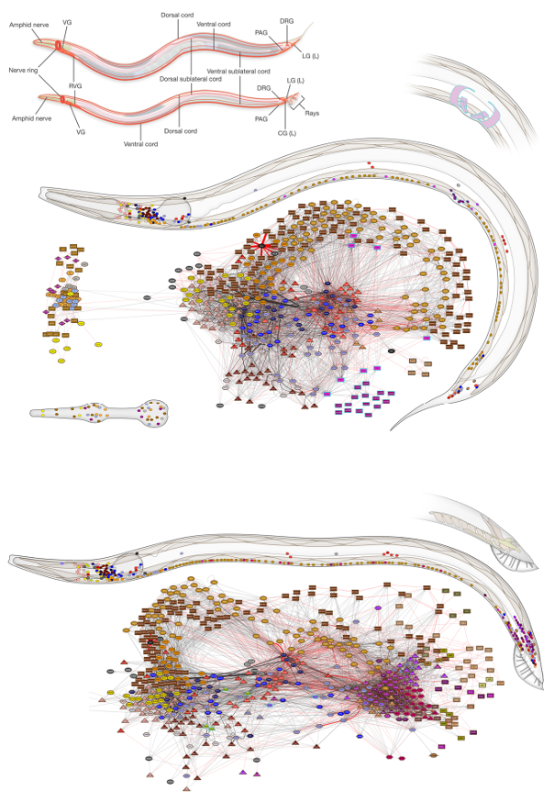
C. elegans as a Model for Foraging Behavior
Short generation times
Simple in terms of behavior
Size
Cook, S. et. al., Nature, 2019.
Notes:
Size allows us to observe their foraging behaviors for a long time

Slide 4
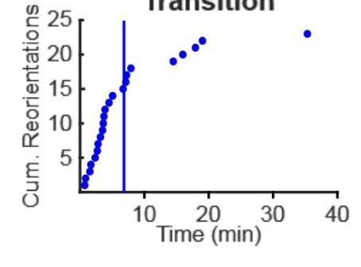
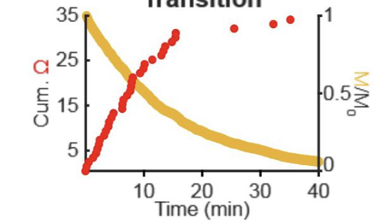
Reorientations are Stochastic
Experimental Data:
Modelled Data:
Cum. Reorientations
= Decaying Signal of memory of food
Margolis & Gordus., eLife, 2025.
Notes:
absence of food C. elegans enter a foraging state where they will randomly search for the next food patch
But the timescale of these random motions or reorientations change over time
Initially reorientation high = small diffusion constant
As time goes on reorient less = diffuse faster which is more effective for foraging
Prev. student modelled these reorientations as a function of some sort of decaying signal of memory of food

Slide 5
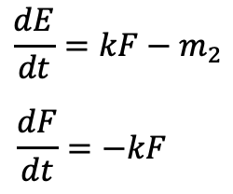
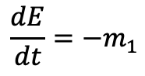
Marginal Value Theorem: The Optimal Time to Leave
Metabolism on Patches:
Energy intake
Rate of food loss
Metabolism between Patches:
Energy Spent
Created by Andrew Gordus
Charnov, E.L., Theoretical Population Biology 1976.
Notes:
If you take these a equations and solve for the average energy over time you get
Label all the variables just for metabolism on patches
Add animation that highlights top metabolism

Slide 6
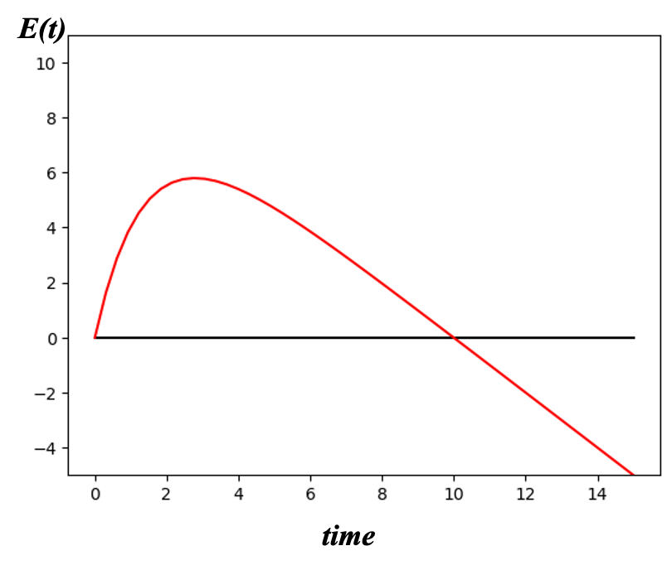
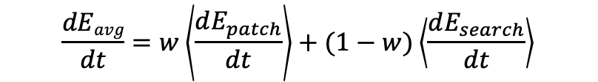
Marginal Value Theorem: The Optimal Time to Leave
w = relative fraction of energy
On Patch
On Patch
Off Patch
Energy Increase
Energy Decrease
Starvation
Created by Andrew Gordus
Charnov, E.L., Theoretical Population Biology 1976.
Notes:
If you integrate this equation over time you get this graph on the left
If you take into account the energy cost of
w is on the screen = Relative fraction of energy
Label off patch on graph

Slide 7
Marginal Value Theorem: The Optimal Time to Leave
High Density
Low Density
On Patch
Off Patch
Energy Increase
Energy Decrease
Requires knowledge of patch density
Starvation
Assumes velocity is constant
Made by Andrew Gordus
Notes:
Animals should leave patch when rate of energy acquisition matches the average energy density of the environment
Assumes velocity is constant bt patches which we know is not true
We would like to test this idea along with the idea that memory is involved in foraging to create a predictive model.

Slide 8
Research Questions
1. How does memory of food encounter affect reorientation rates?
2. How does velocity change between food patches?

Slide 9
Aims For Rotation
Recreate experimental design from Lopez-Cruz et. al used in Margolis and Gordus
Adjust Worm Tracking Code
Collecting Reorientation Rates and Velocity
Notes:
The Margolis Paper modeling reorientations was based on the data from the Lopez Cruz paper so the first aim of this rotation was to recreate this design to test this further

Slide 10
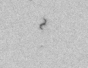
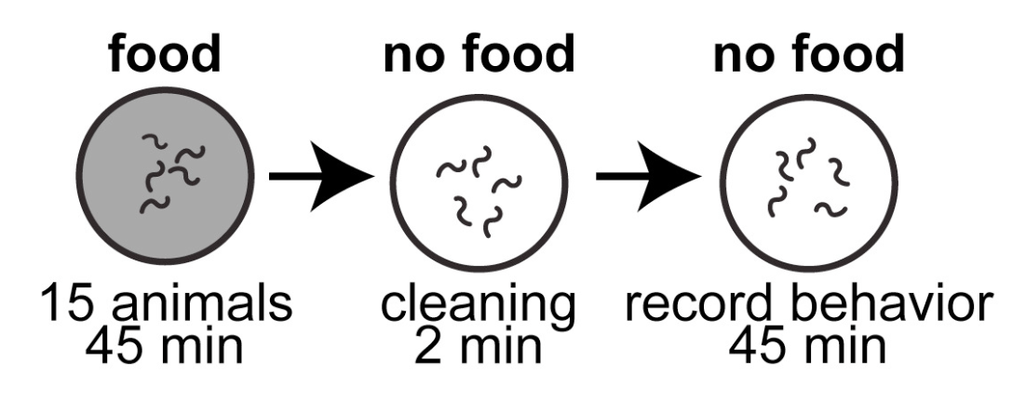
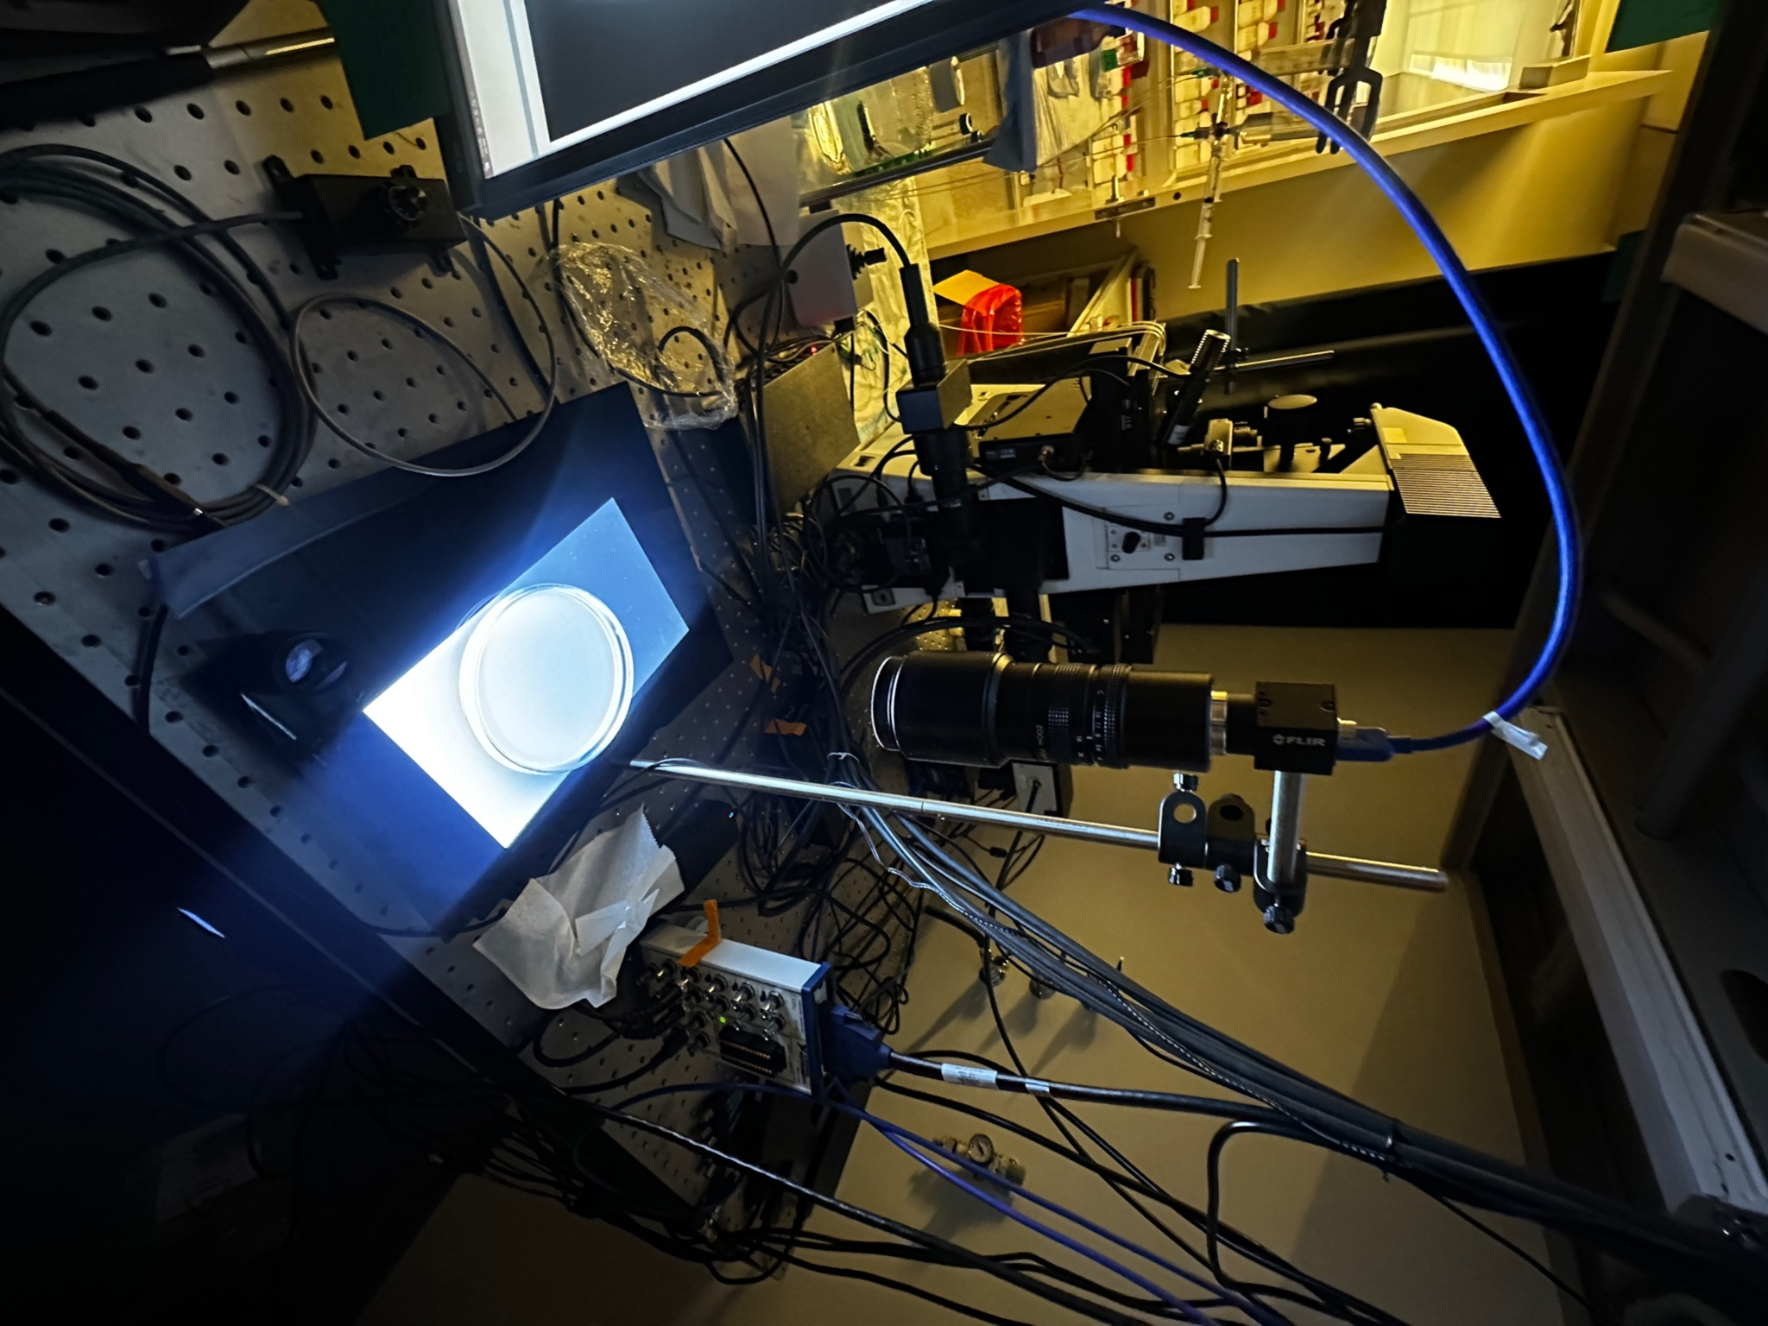
Recreation of Experimental Design
Camera
Light Source
15 cm Plate
López-Cruz, A. et. al., Neuron, 2019.
Notes:
12 megapixel camera with wide field of few so each worm is a couple pixels large
12 megapixel camer = lots of information being saved by computer
Limiting the # fr/s bc the computer can only handle so much information at a time
Can't compress images to make saving faster bc worms are small
Streamline words better

Slide 11
Aims For Rotation
Recreate experimental design from Lopez-Cruz et. al used in Margolis and Gordus
Adjust Worm Tracking Code
Collecting Reorientation Rates and Velocity
Notes:
Jeff Joe and Andrew Margolis

Slide 12
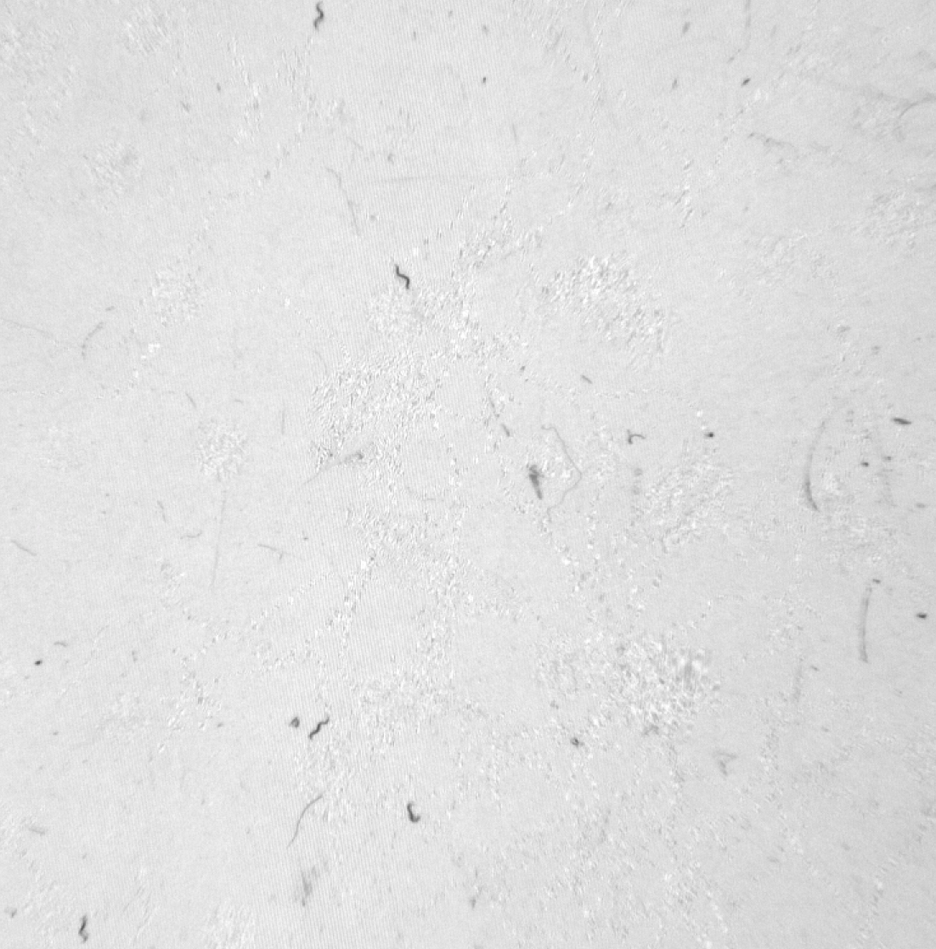
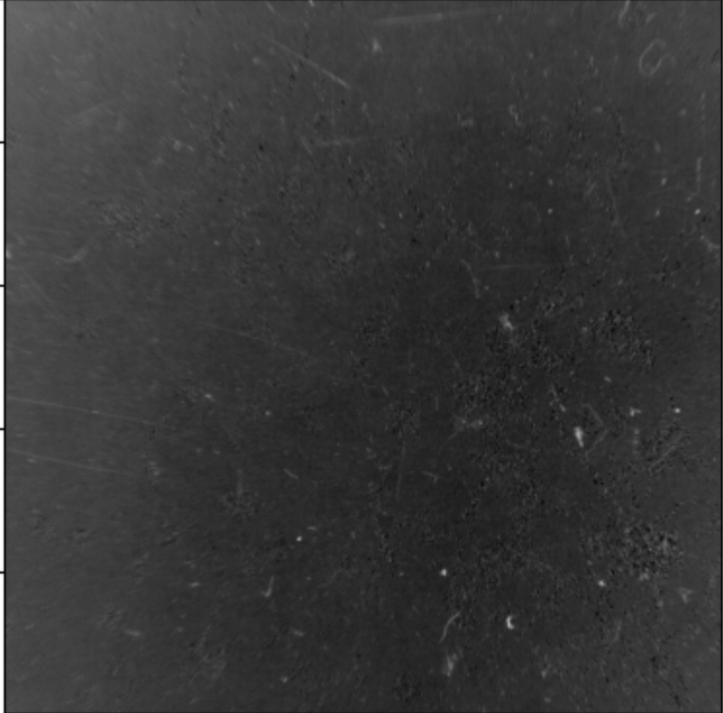
Code Workflow: Subtract Average Image from All Frames
Subtract Average Image
Set Background Threshold
Erosion/Dilation
Image before Subtraction
Average Image
Loop Through Frames
Notes:
Andrew Margolis and Jeff Zhou
Show raw image, average and what the final image looks like once substracted
Minimize background

Slide 13
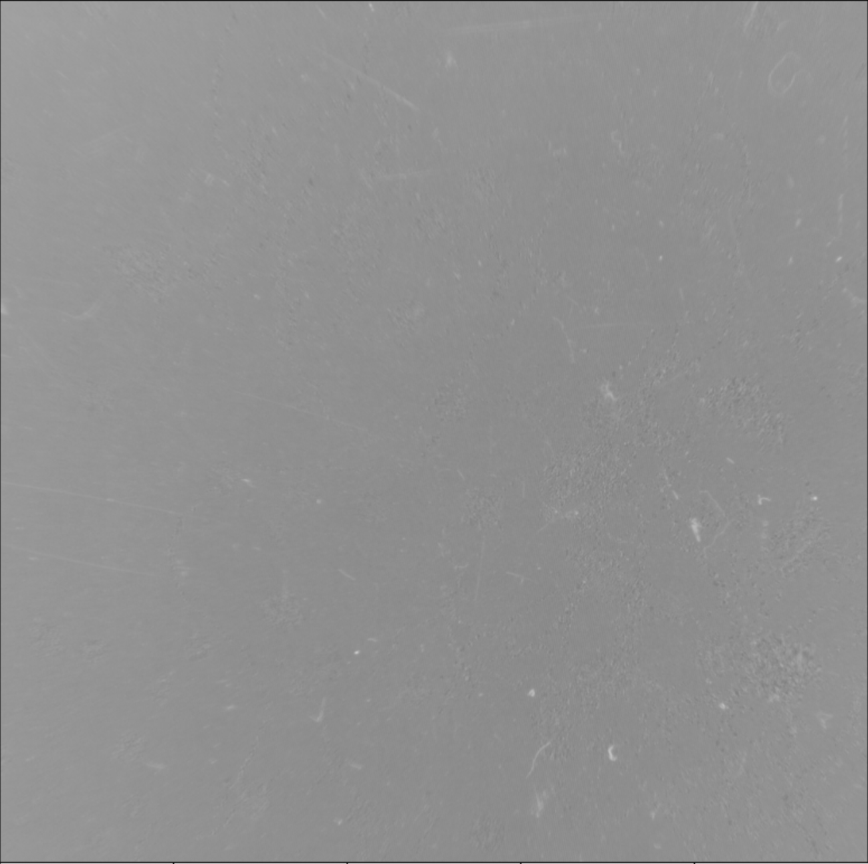
Code Workflow: Subtract Average Image from All Frames
Subtract Average Image
Set Background Threshold
Erosion/Dilation
Loop Through Frames
Image after Subtraction
Notes:
Andrew Margolis and Jeff Zhou
Minimize background

Slide 14
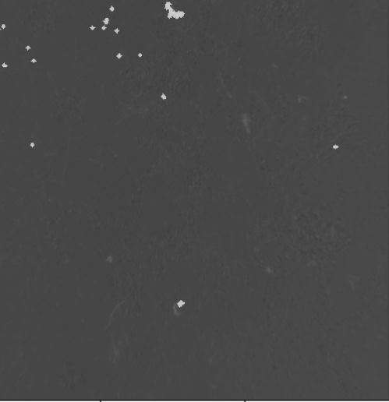
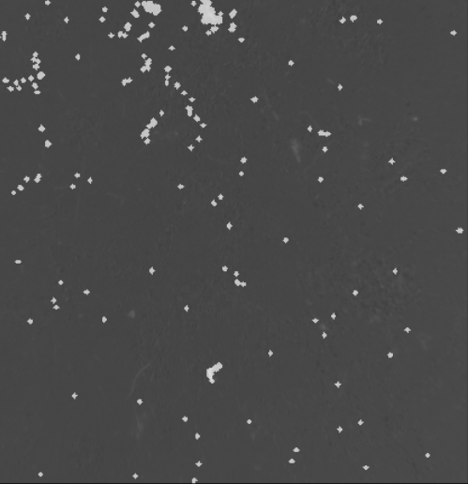
Challenges of Code: Background Threshold
Subtract Average Image
Set Background Threshold
Erosion/Dilation
Loop Through Frames
High Threshold
Low Threshold
Notes:
Remove more noise based on lighting
This determines how strong a pixel must deviate from background noise to be considered part of the worm
Correct threshold important bc
Too low -> too much noise
Too high -> miss parts of the worm
Makes reference image brighter or darker

Slide 15
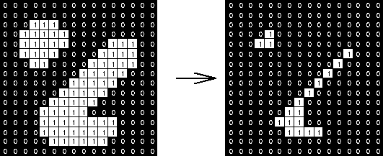
Challenges of Code: Erosion and Dilation
Subtract Average Image
Set Background Threshold
Erosion/Dilation
Loop Through Frames
Notes:
Erase particles (dist or fibers)

Slide 16
Challenges of Code: Search Radius
Subtract Average Image
Set Threshold
Erosion/Dilation
Loop Through Frames
Frame 1
Frame 2
Notes:
In order to track the worms we set search radius
Allows for linking up of each worm
This radius correct Worm cannot physically go farther than this radius
Worm can only displace a certain distance
Must find sweetspot of moving w/in radius

Slide 17
Aims For Rotation
Recreate experimental design from Lopez-Cruz et. al used in Margolis and Gordus
Adjust Worm Tracking Code
Collecting Reorientation Rates and Velocity

Slide 18

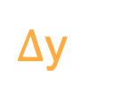
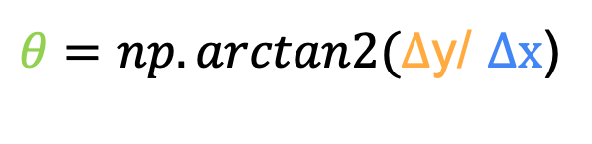

Calculating Reorientation Rates
f = frame of interest
f + n
$θ=np.arctan2(∆$y/ $∆x$)
f
$∆$y
f - n
$$θ$$
$$∆x$$
Notes:
Arctan gives you the angle of displacement

Slide 19
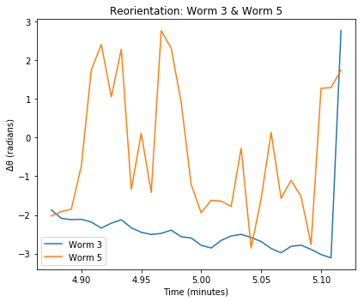
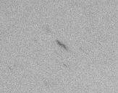
Successfully Tracked Reorientations of Worms
Reorientation
No Reorientation
Notes:
Calculated by calc the angle of of displacement
Make slide before this about how we calculate the reorientation
Emphasize its showing a small clip not whole vid

Slide 20
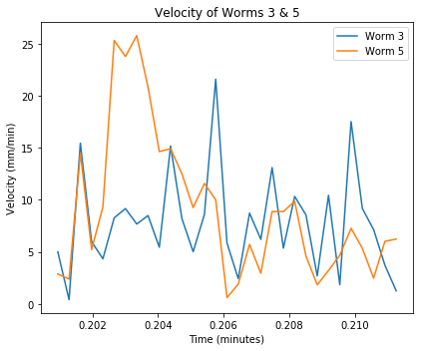
Successfully Calculated the Velocity of Worms
Notes:
Get the velocity of worms bt patches based on past memory of food
Goal is to look at reorientation rates/ velocity

Slide 21
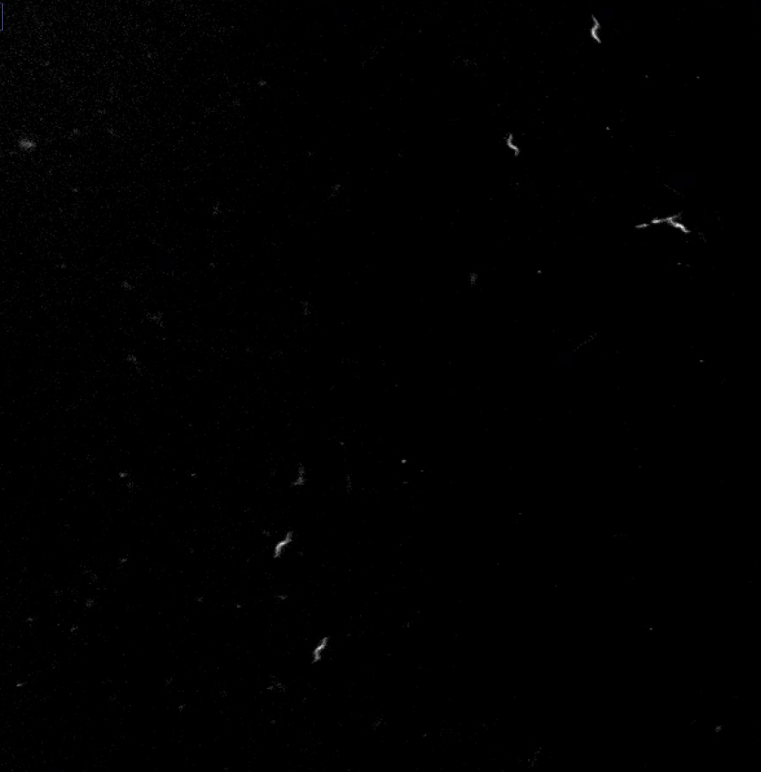
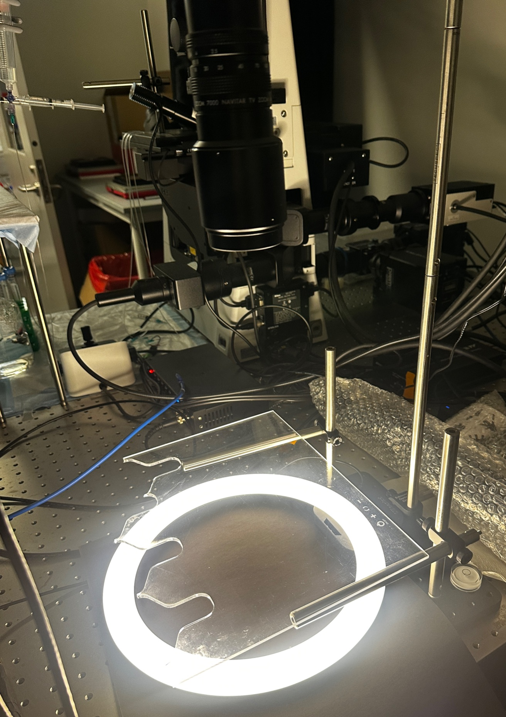
Future Directions: Using a Ring Light
Notes:
Predictive model capable of predicting foraging decisions based on experience, memory state, and sensory input (BD)
Using ring light instead to help with the static background since avg image subtraction does take away all noise
Training a machine vision model to identify the worms
Adding different food densities
Figuring out neurons necessary for foraging
Predictive model

Slide 22
Future Directions
How does bacterial density influence the rate of patch leaving and reorientation rates off of food?
Define rate of memory consolidation
Notes:
Bact:
Diff densities
patch leaving rate as well as the initial reorientation rate after leaving a patch
quantify how past food experiences influence path-leaving decisions under current conditions. In separate experiments, I will take worms raised on different food densities, and quantify their initial reorientation rates when placed off of food
MAIN: will the worms leave faster(MVT) if the patch they just came off of had higher bacterial density
Will reorientation rates change if they just came off a high density patch
Mem
Starve worms for 45 minutes
See how reorientations change (if a model of decaying signal since the last food encounter then reorient should go down)

Slide 23
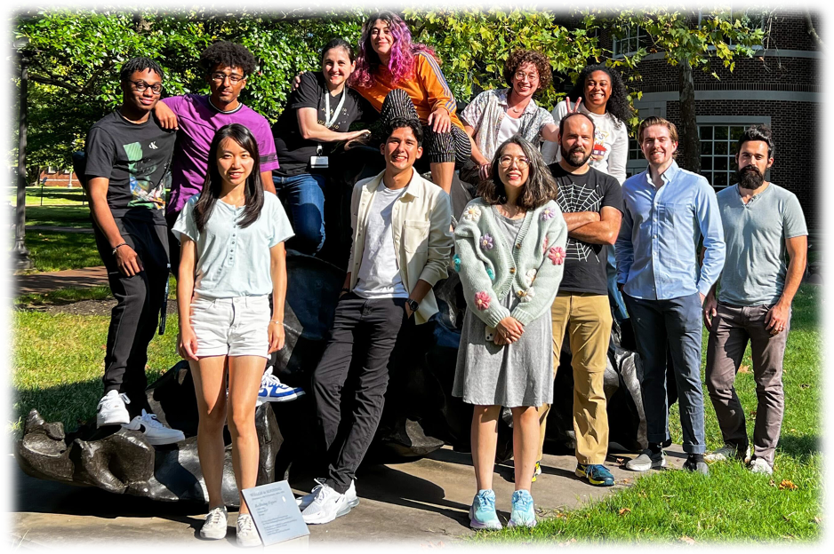
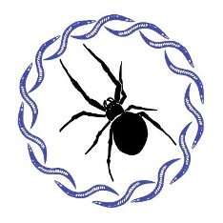
Acknowledgements
Gordus Lab:
Andrew Gordus
Amanda Ray
Andrew Margolis
CMDB Faculty:
Kat Tassia
Alecia Flynn
First-year Cohort

